Slide 1
Software Design and Analysis
Logical Models: Interaction Models
Communication/Collaboration Diagram
Department of Software Engineering,
FAST-NUCES, CFD Campus

Slide 2
Lecture Material
System Analysis and Design in a Changing World (Chapter 13)

Slide 3
Lecture Outline
Interaction diagrams fundamentals
Sequence diagram fundamentals
SD design guidelines
Example

Slide 4
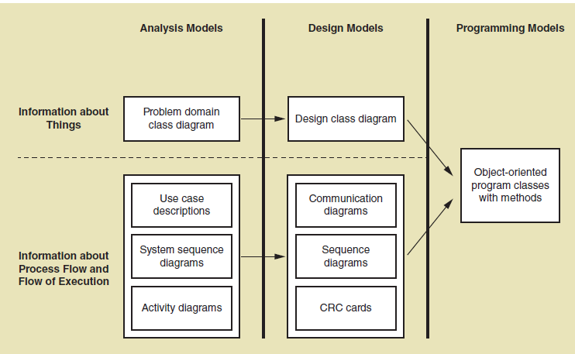
Class Diagram Fundamentals

Slide 5
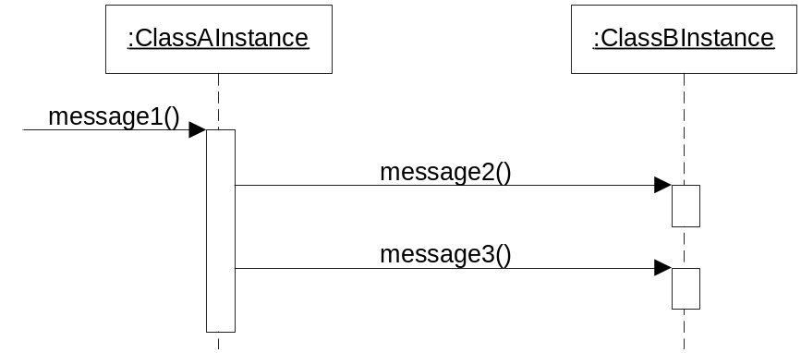
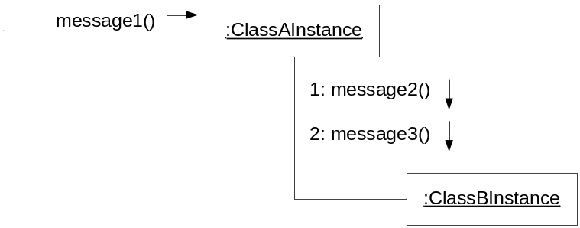
Interaction Diagram Fundamentals
Sequence diagram
Communication diagram

Slide 6
Collaboration/Communication Diagram
A Collaboration is a collection of named objects and actors with links connecting them.
A Collaboration between objects working together provides emergent desirable functionalities in Object-Oriented systems.
Objects collaborate by communicating (passing messages) with one another in order to work together

Slide 7
Collaboration/Communication Basics
Objects
Links
Messages

Slide 8
Collaboration Diagram Syntax
AN ACTOR
AN OBJECT
AN ASSOCIATION
A MESSAGE
anObject:aClass
aMessage()

Slide 9
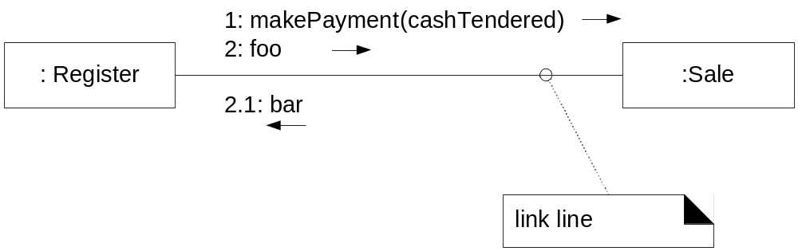
Collaboration/Communication Diagram

Slide 10
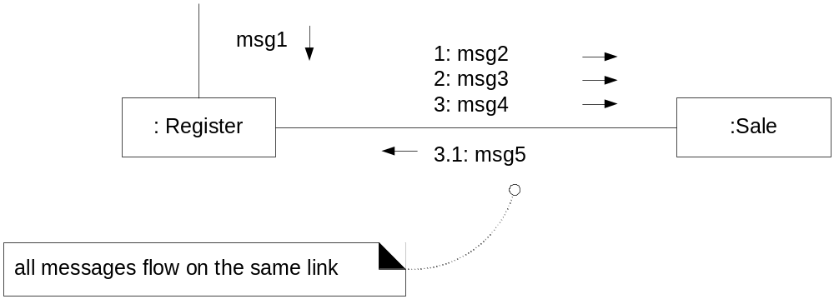
Collaboration/Communication Diagram

Slide 11
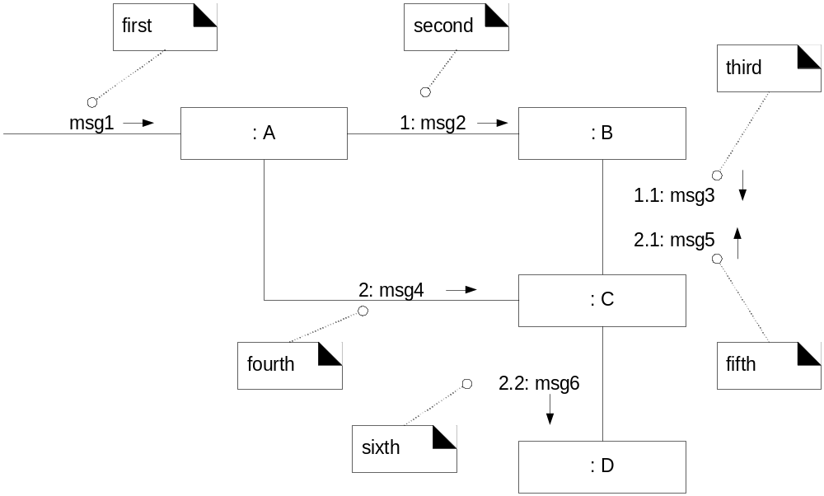
Collaboration/Communication Diagram – Message numbering

Slide 12
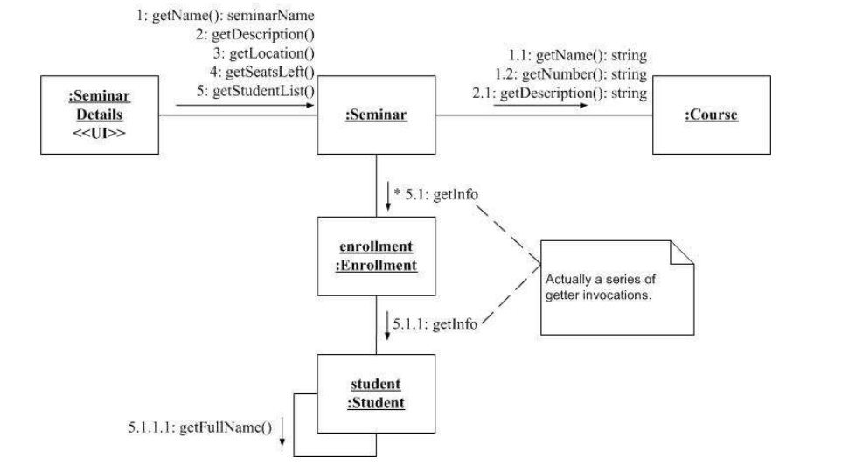
Collaboration/Communication Diagram

Slide 13
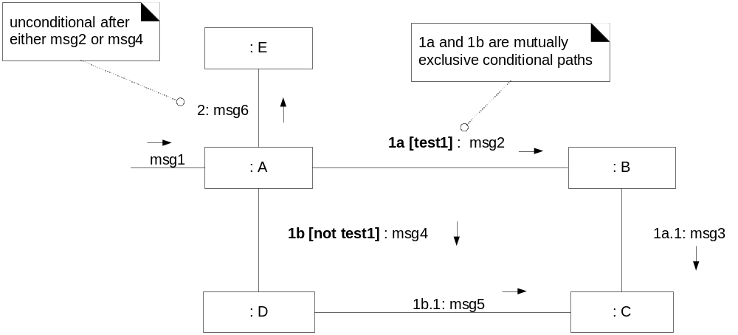
Collaboration/Communication Diagram
Mutually Exclusive Conditional Paths

Slide 14
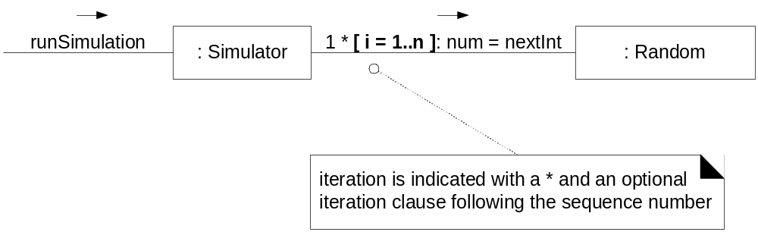
Collaboration/Communication Diagram
Iterations

Slide 15
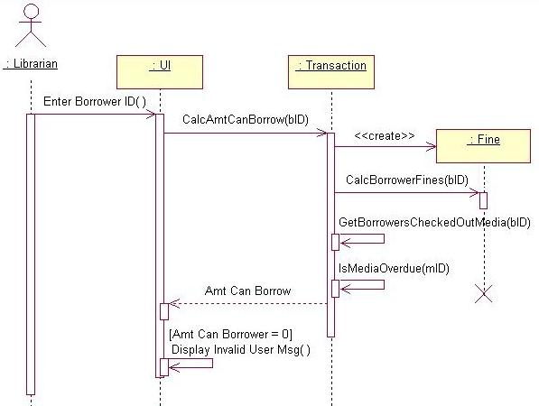
Sequence diagram is better at ‘time ordering’

Slide 16
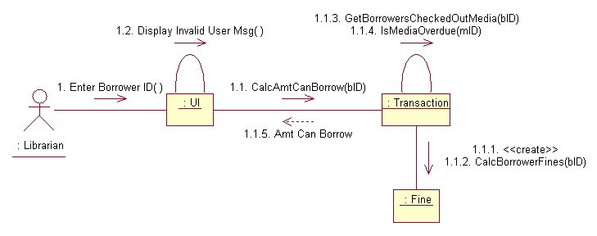
Collaboration diagram is better at showing the relationship between objects

Slide 17
Activity
Let's do a communication diagram for the following casual use case, Add Calendar Appointment :
  The scenario begins when the user chooses to add a new appointment in the UI. The UI notices which part of the calendar is active and pops up an Add Appointment window for that date and time.
  The user enters the necessary information about the appointment's name, location, start and end times. The UI will prevent the user from entering an appointment that has invalid information, such as an empty name or negative duration. The calendar records the new appointment in the user's list of appointments. Any reminder selected by the user is added to the list of reminders.
  If the user already has an appointment at that time, the user is shown a warning message and asked to choose an available time or replace the previous appointment. If the user enters an appointment with the same name and duration as an existing group meeting, the calendar asks the user whether he/she intended to join that group meeting instead. If so, the user is added to that group meeting's list of participants.

